Slide 1
Step by step setup FTP in kali linux and conncting through windows
CNS Project

Slide 2
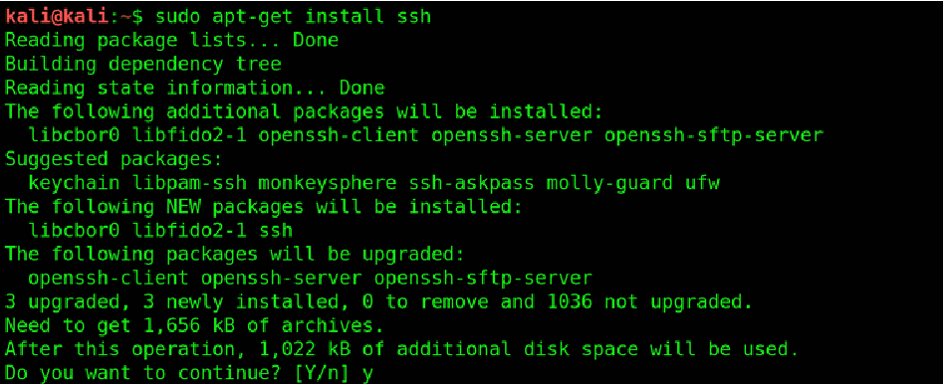
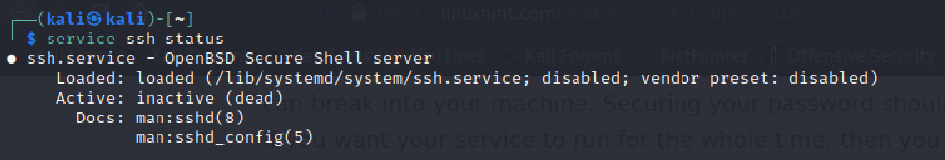
$ sudo apt-get install ssh
service ssh status

Slide 3

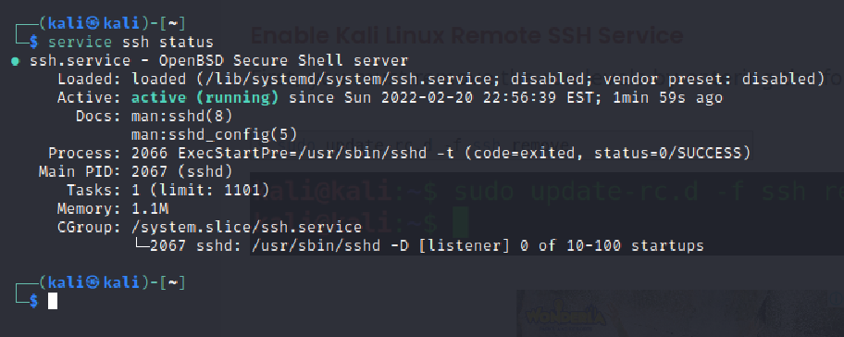
service ssh start
service ssh status

Slide 4
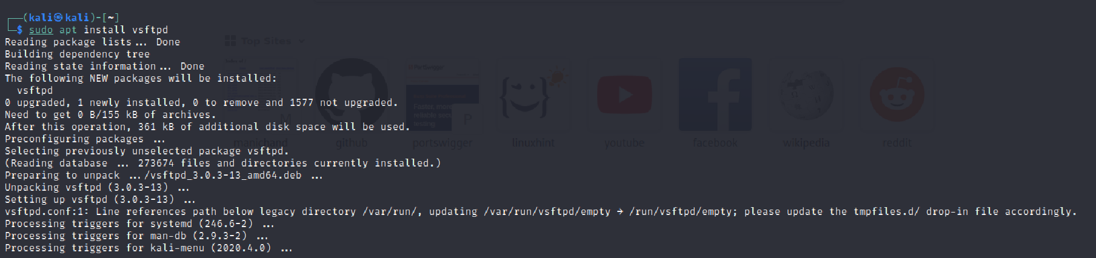

sudo apt install vsftpd
sudo su root

Slide 5
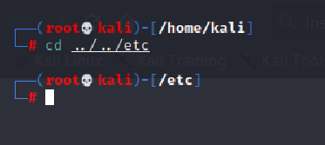
Cd ../../etc

Slide 6

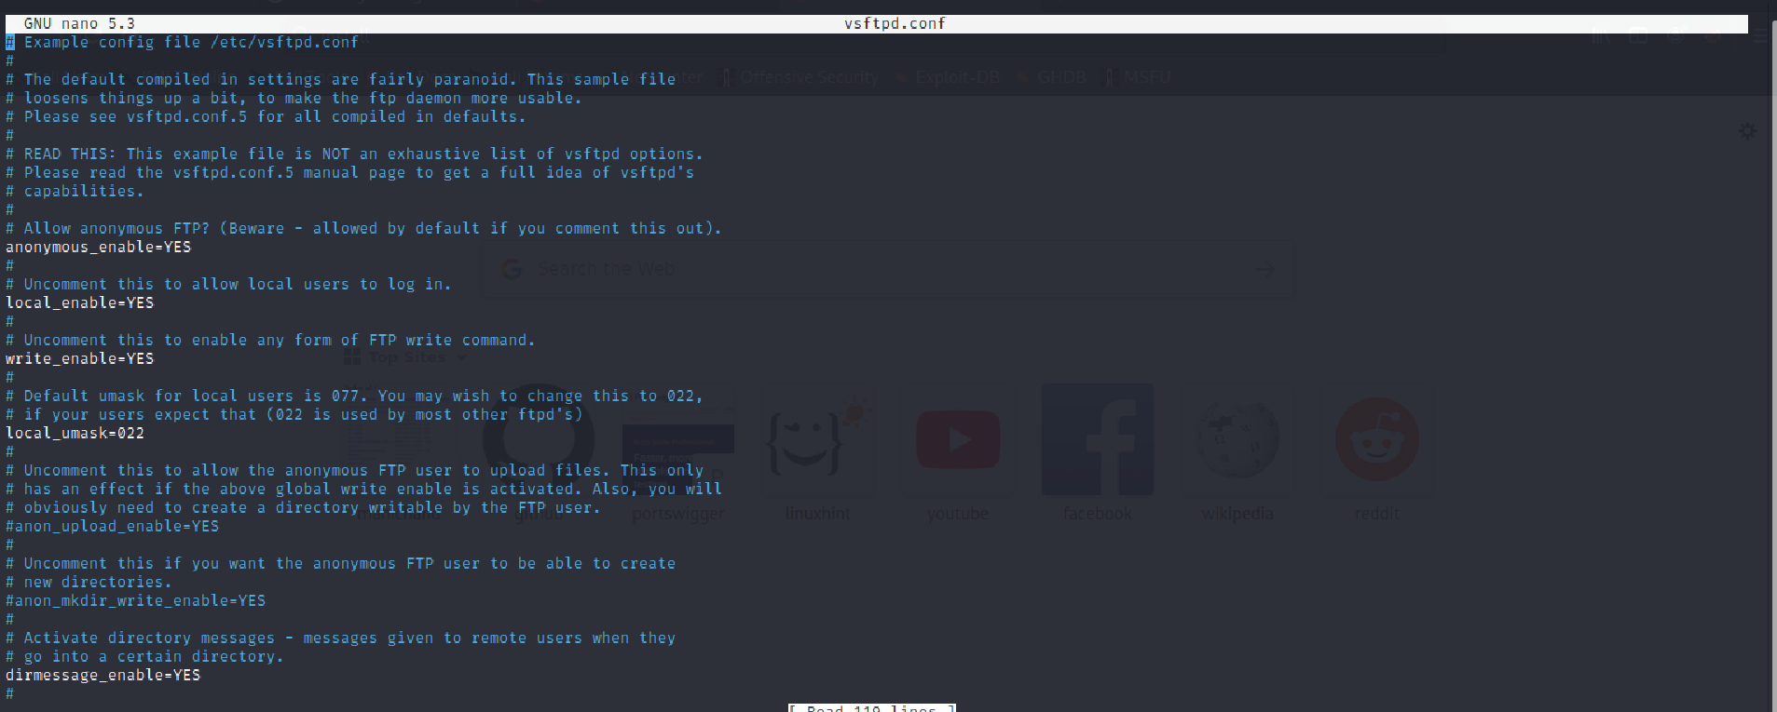
nano vsftpd.conf

Slide 7
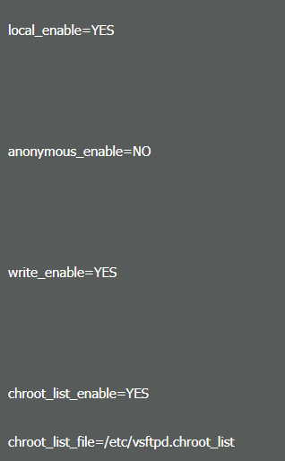
you have to uncomment all these lines i have mentioned below.

Slide 8
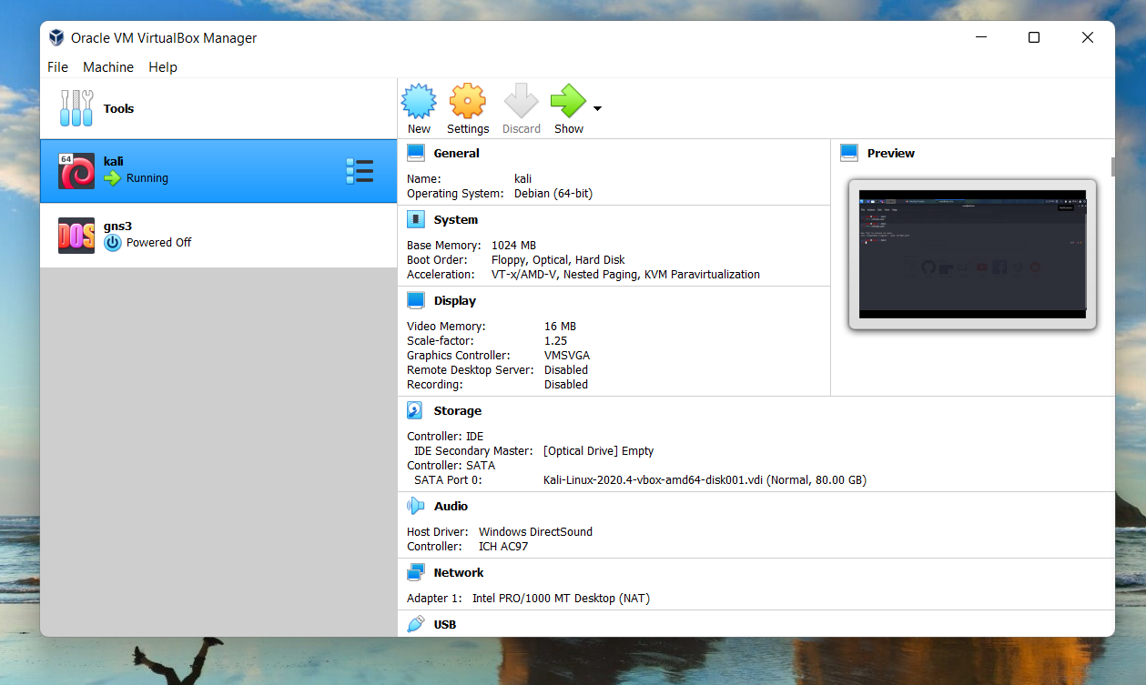

Open virtual box and select kali

Slide 9
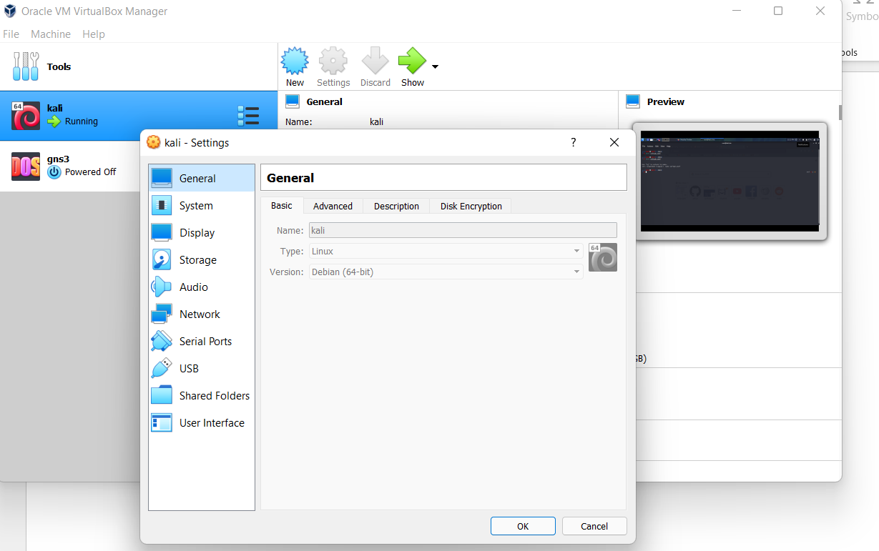

Click on settings

Slide 10
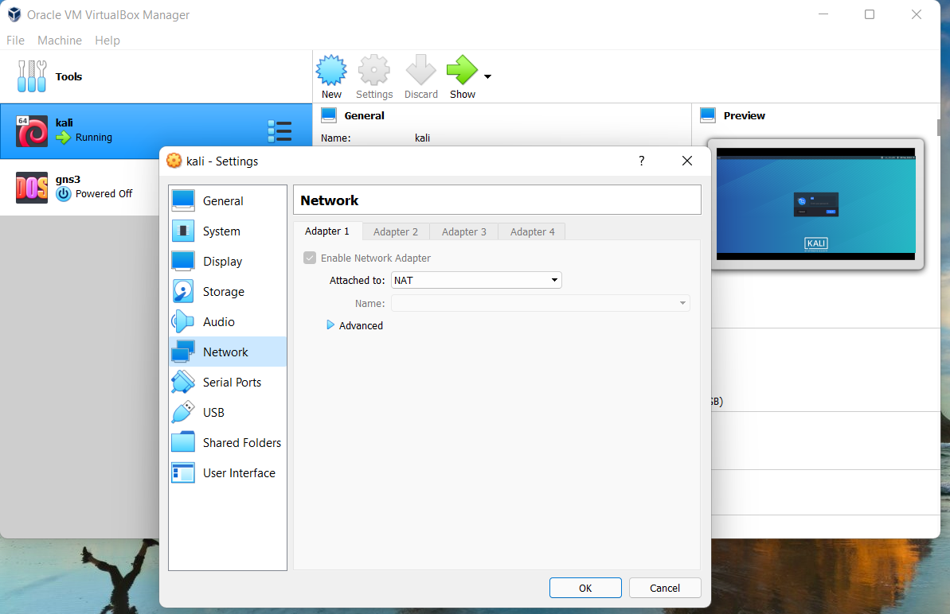

>Click on network
> Click on advanced

Slide 11
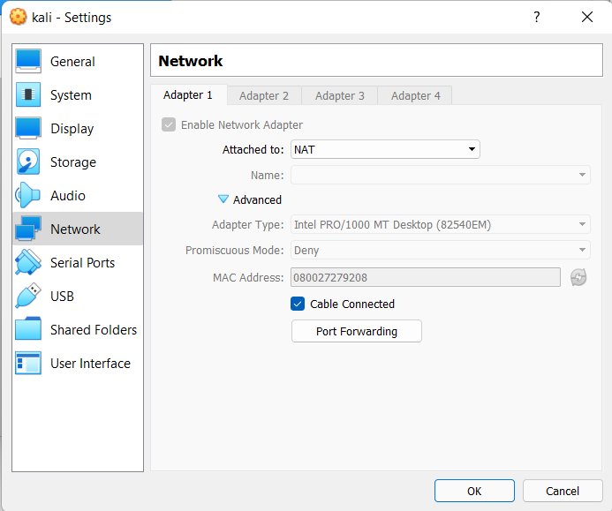

Click on advance
Click on port forwarding

Slide 12
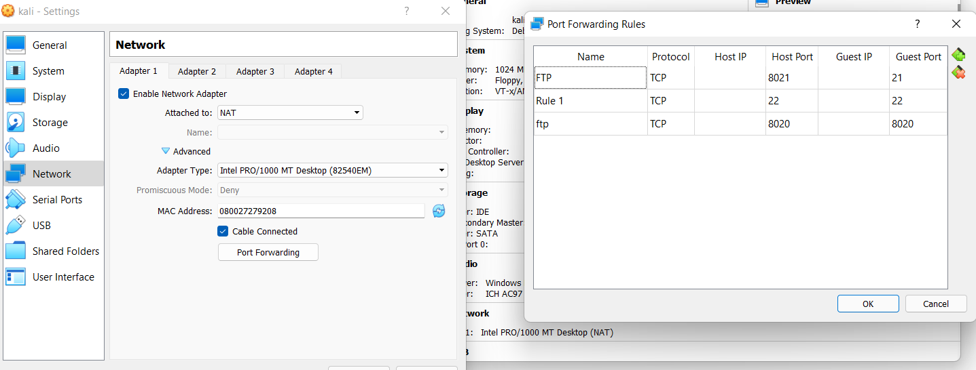



To ADD
Add the three rules in port fowarding
Now reboot the kali

Slide 13
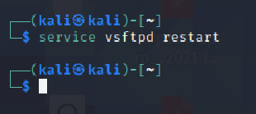
service ssh start
service ssh status
service vsftpd restart

Slide 14
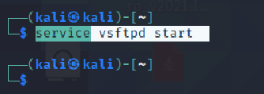
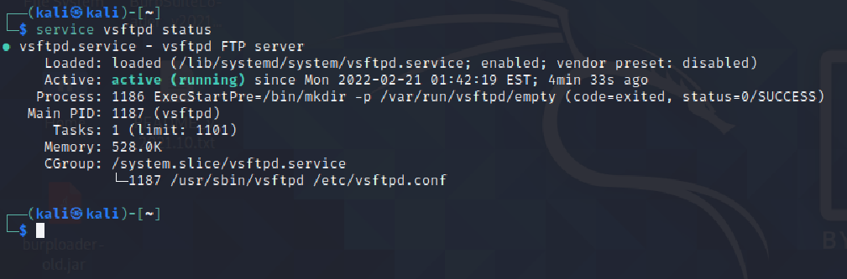
service vsftpd start
service vsftpd status
Now , open command prompt

Slide 15
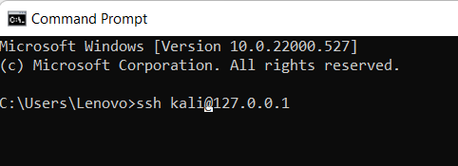
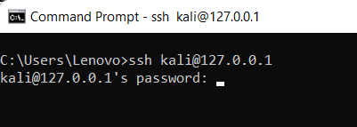
Now , open command prompt
ssh [username of kali]@127.0.0.1
Enter the password of kali

Slide 16
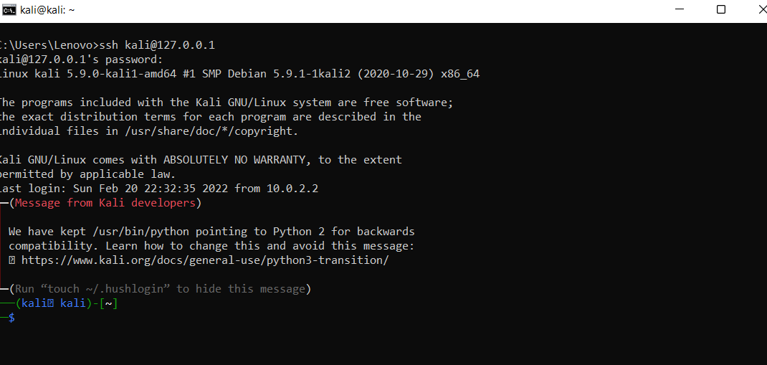
It will open in this way

Slide 17
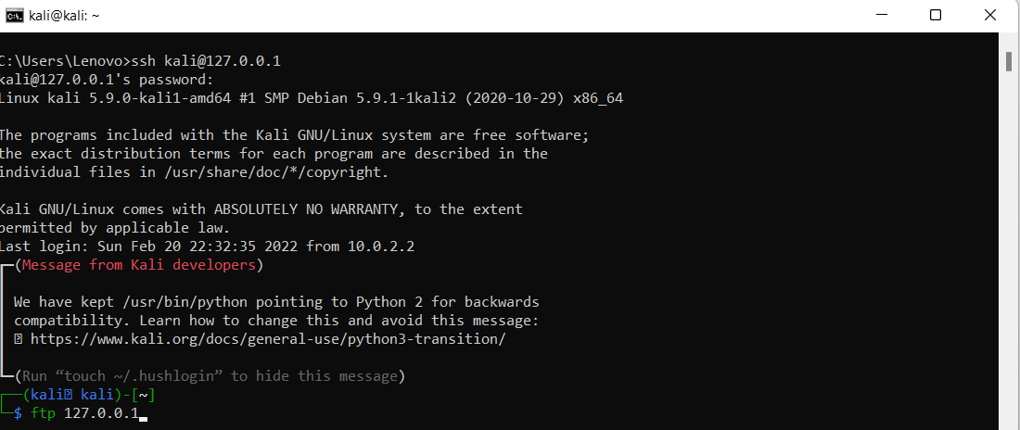
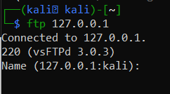
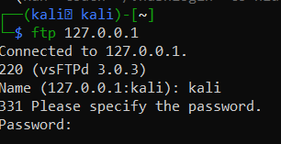
Now enter the following command
ftp 127.0.0.1
Enter the user name
Enter the password

Slide 18
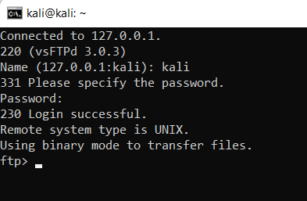
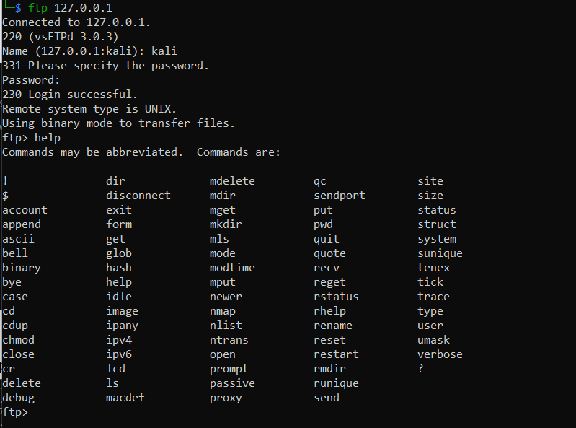
After that enter
help

